Slide 1

ENGG. MATHEMATICS(EE 202)
By,
JAYDEV KAMANI
U19EE006
&
AVIRAJ RATHOD
U19EE009
Faculty Advisor-
Prof. A.K.Panchal
Electrical Engg. Department
S.V.National Institute of Technology-Surat

Slide 2

HONOR CODE
WE CERTIFY THAT WE HAVE WORKED ALL THE THINGS ON OUR OWN , THAT WE HAVE NOT COPIED OR TRANSCRIBED CODES FROM CLASSMATE , SOMEONE OUTSIDE CLASS OR FROM ANY OTHER SOURCE. WE ALSO CERTIFY THAT WE HAVE NOT FACILITATED OR ALLOWED ANY OF OUR CLASSMATES TO COPY ANYTHING FROM OUR PROJECT WORK.

Slide 3
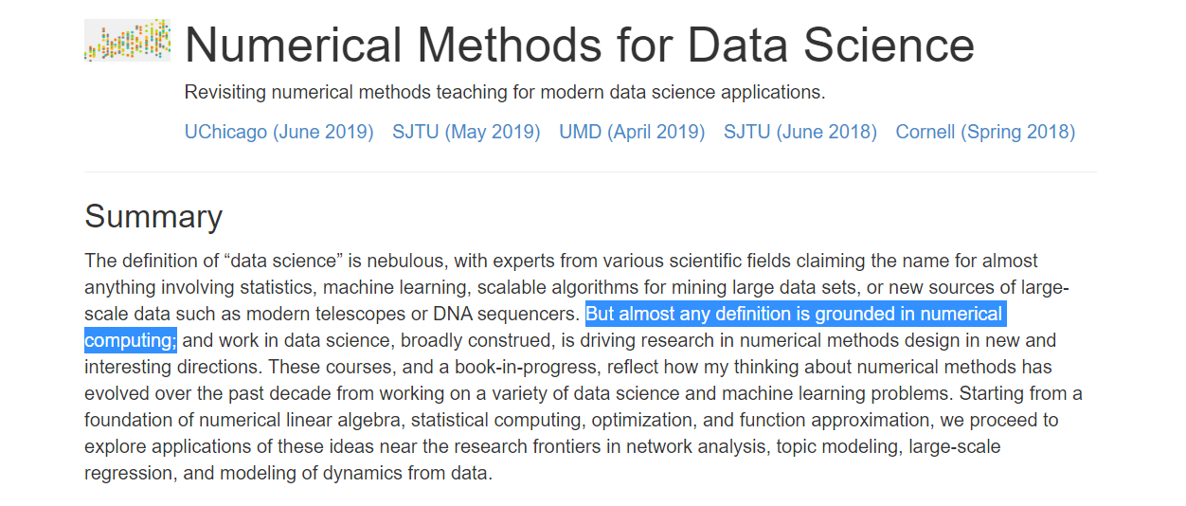
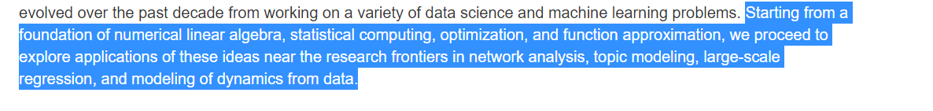
Selecting real life problem to solve using engineering numerical Methods.

Slide 4

DMart, is an Indian retail corporation that operates a chain of hypermarkets in India founded by Radhakishan Damani in the year 2002.
Revenue: 24,930 crores INR (US $3.5 billion, 2020)
Analysis of D’Mart value dataset using Numerical approach

Slide 5
We Used Numerical predictions in below tasks
Comparison of Intermediate value & prediction of future value.
Effect of external parameters on data & their calculation
Data-Set
Comparing with other similar dataset
Fluctuation of data values in particular intervals.

Slide 6
*This stock was listed on 21/03/2017 and we took values at interval of 2 months As below.
TIME | PRICE(INR)
3/21/2017 | 640.75
5/22/2017 | 721.50
7/21/2017 | 913.90
9/21/2017 | 927.35
11/21/2017 | 1112.35
1/22/2018 | 1176.55
3/21/2018 | 1337.85
5/21/2018 | 1347.95
TIME | PRICE(INR)
7/20/2018 | 1516.75
9/21/2018 | 1500.65
11/21/2018 | 1419.05
1/21/2019 | 1350.65
3/22/2019 | 1501.80
5/21/2019 | 1273.60
7/22/2019 | 1416.75
9/20/2019 | 1759.10
TIME | PRICE(INR)
11/21/2019 | 1819.95
1/21/2020 | 1916.85
3/20/2020 | 1923.10
5/21/2020 | 2470.50
7/21/2020 | 2040.45
9/21/2020 | 2093.35
11/20/2020 | 2379.35
1/21/2021 | 2717.95

Slide 7
For finding intermediate data values we can use interpolation methods And for that we have many Interpolation methods such as…
Direct method of Interpolation
Lagrange’s method of Interpolation
Newton’s Divided difference
Newton’s Forward & Backward difference (Only for equal intervals)
Spline Method of Interpolation

Slide 8
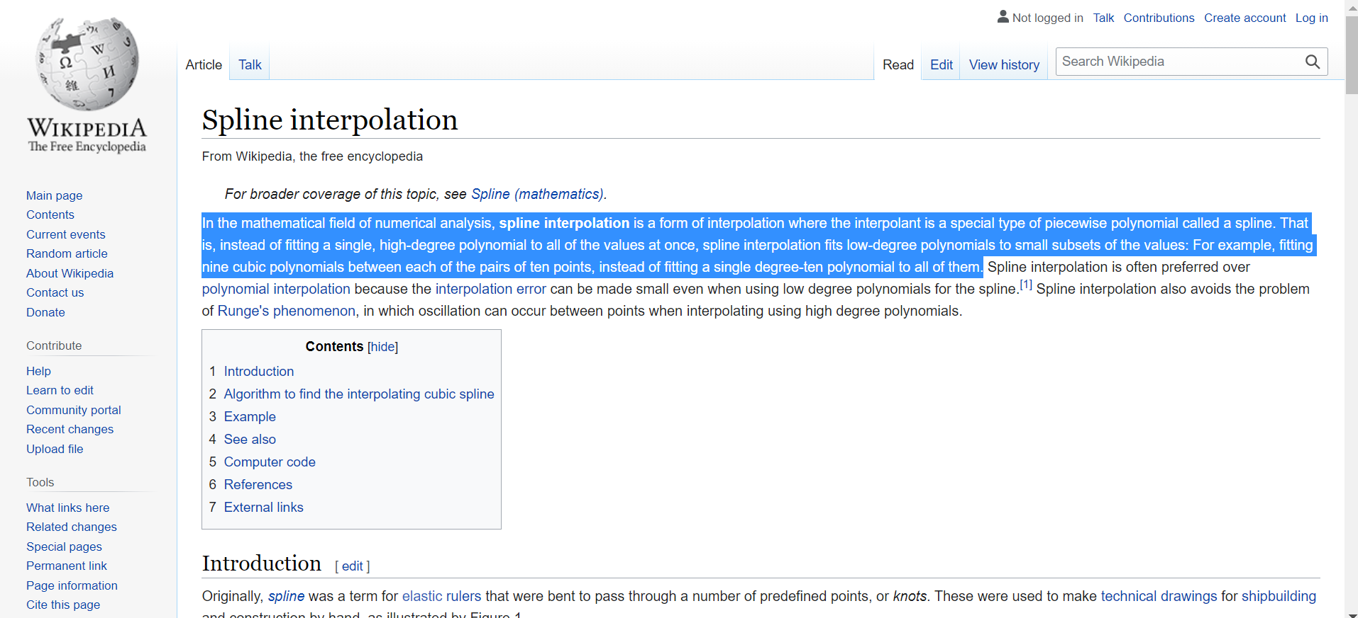

Slide 9
So Results of interpolation with Different methods are as below
 | Actual Value | Value found | Absolute Error
Direct method | 2237.2 | 2240.3 | 3.133206
Lagrange method | 2237.2 | 2240.3 | 3.135154
Newton Forward difference | 2237.2 | 2233.8 | 3.421094
Newton Backward difference | 2237.2 | 2233.8 | 3.421094
Newton Divided Difference(5th Order) | 2237.2 | 2233.8 | 3.421094
Spline method | 2237.2 | 2237.8 | 0.572581

Slide 10
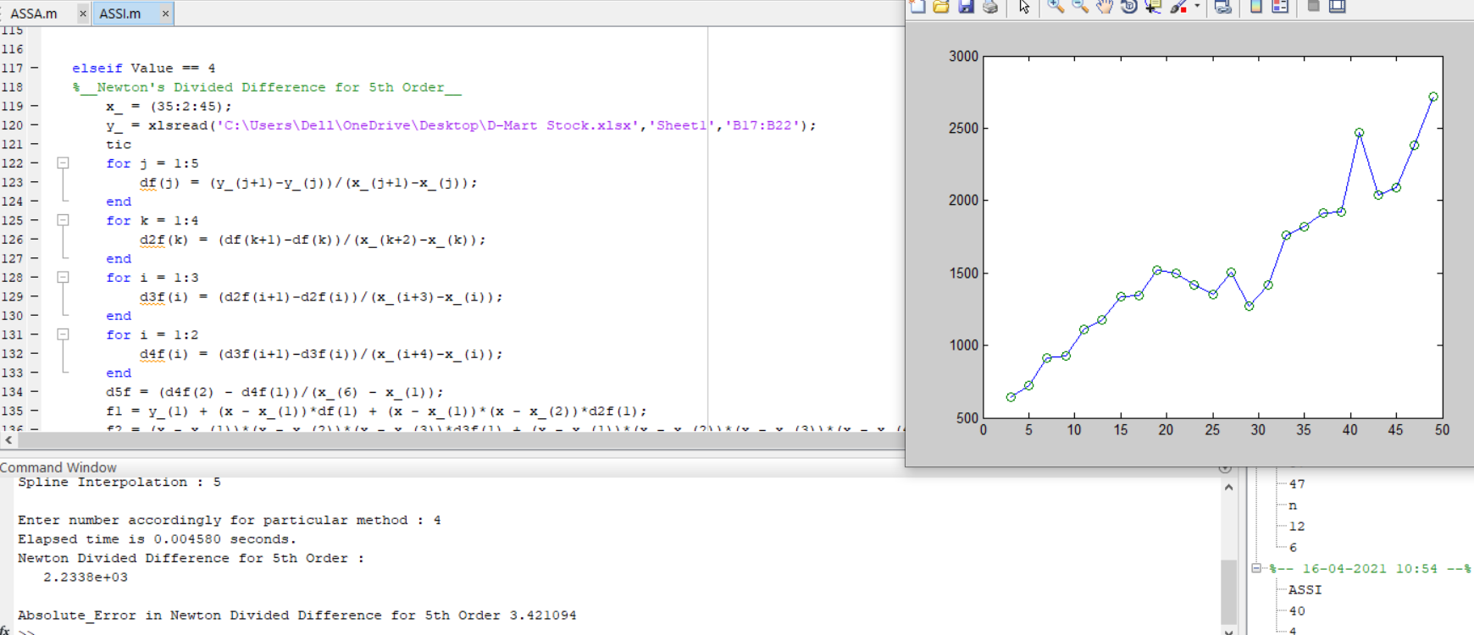

Slide 11
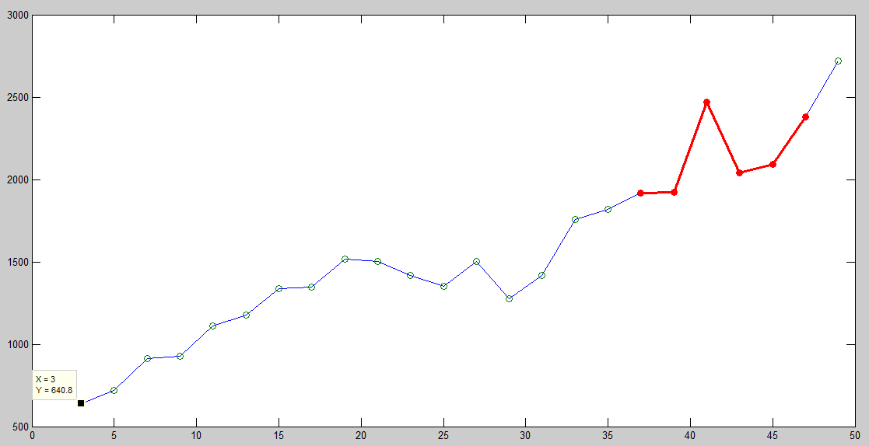
Here is the graph for given data of stock values

Slide 12
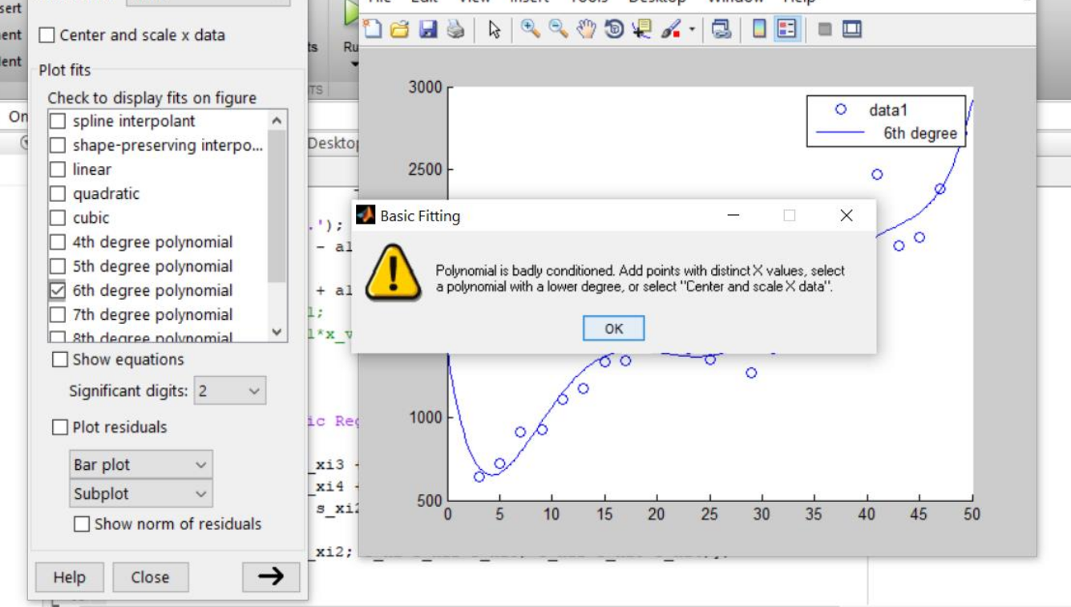
For further analysing we need function occupying all our points And for that we can use Reggersion methods…...
For Reggersion we should take order as much as high to get most accuracy.
Doing higher order operation manually is lengthy but for that we have MATLAB In-Built function “Basicfitting”
The maximum order we can perform for with this function is 10th order.
But with our data set it was showing warning above 6th order.
We used order 10th that was giving Max. Accuracy.
We could not use logarithmic and exponential or any other regression model because of our curve type.

Slide 13
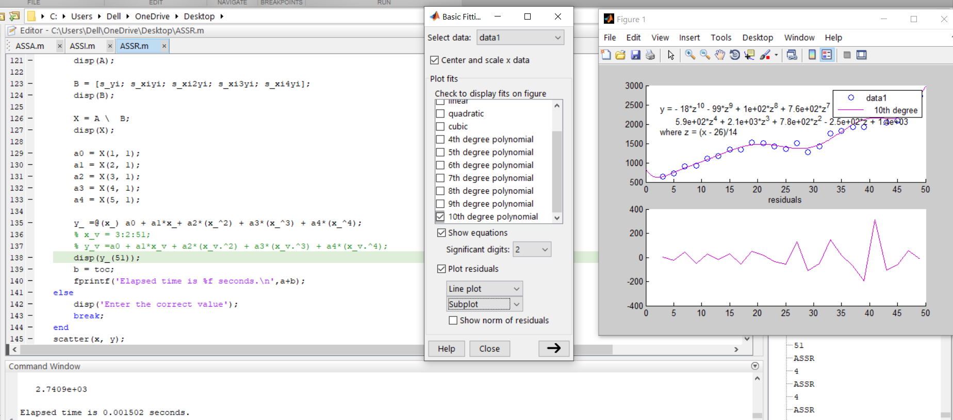
So Our Code and Function got are as below…

Slide 14
For further analysing we need AREA Under our graph , With area we can analyze many things like stability of stock , comparison with other similar stock….
For Area(ie.INTEGRATION) we have many methods as below…
1.Trapezoidal method
2.Simpson’s ⅓ method
3.Simpson's ⅜ method
4.Boole's rule
5.Weddle's rule
6.Gaussian quadrature method
These Methods are derived from Newton-Cotes quadrature formula.
Order of their accuracy is Gaussian>> Boole’s > Weddle’s >Sim.⅜>Sim.⅓>Trapezoidal

Slide 15
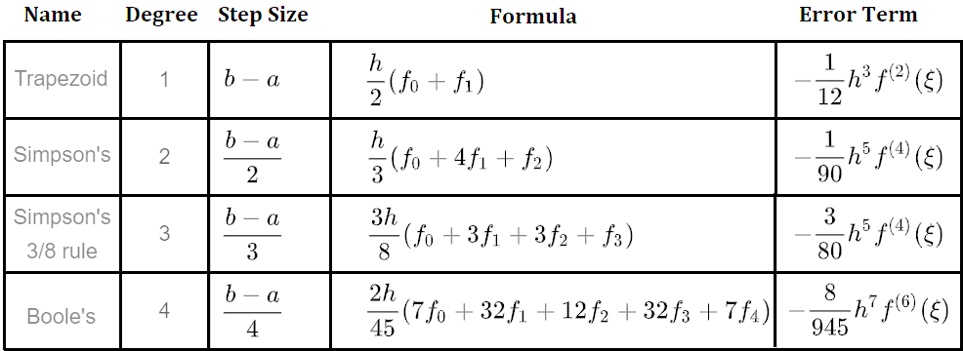
Newton-Cotes quadrature formula.

Slide 16
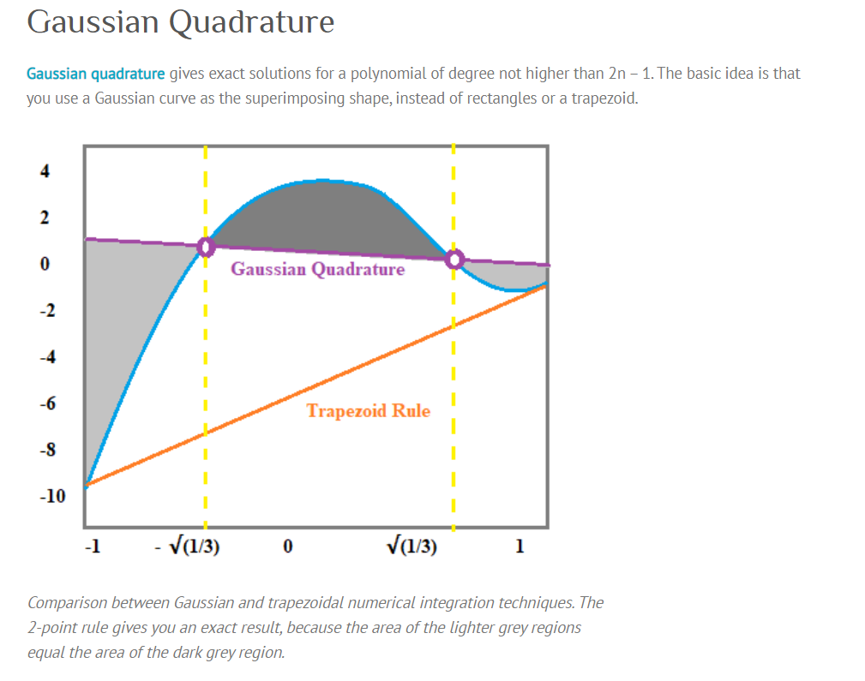

Slide 17
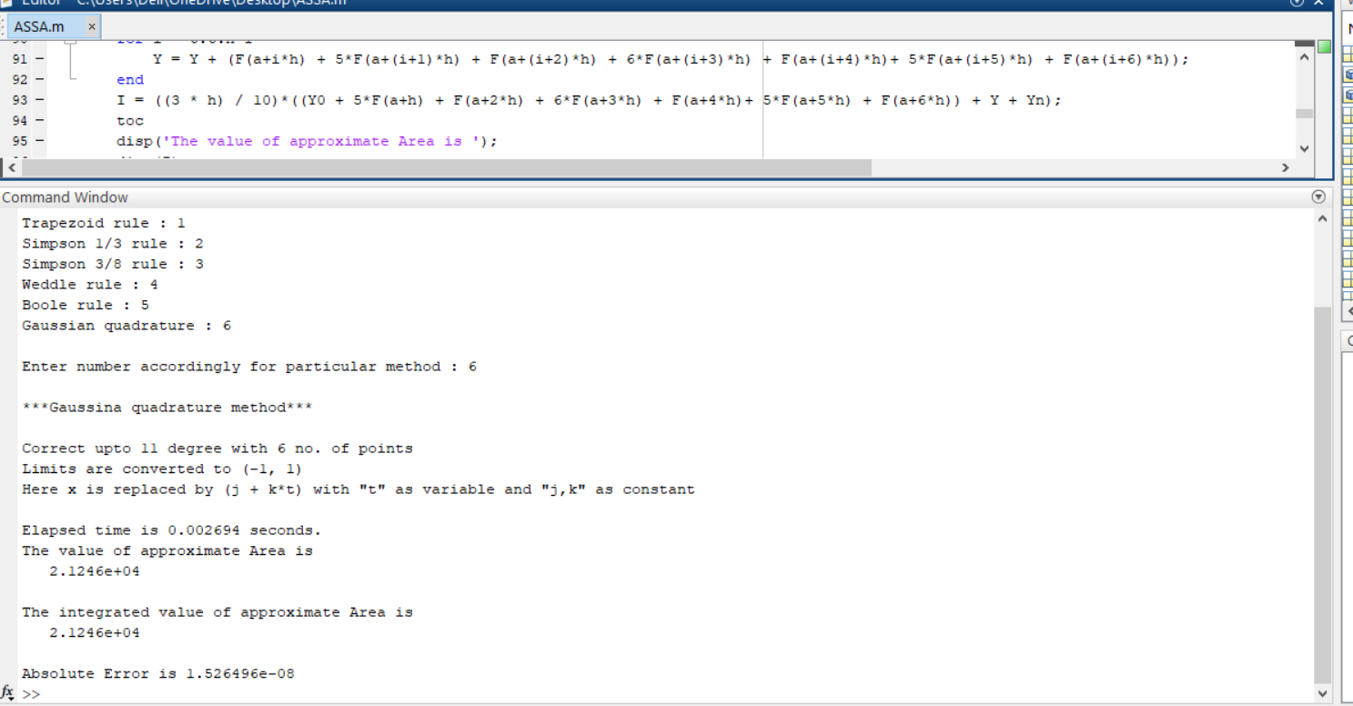

Slide 18
One more aspect of analysing a stock is...
Stability of stock can be checked by analysing Its Maximum Value and Minimum value in intervals(ie. Fluctuation in value)
Less the Fluctuation More The trustable Stock.
For finding Maxima & Minima We need to differentiate our Function .
Then we equated differentiation with zero and found the equation.
And Roots of that equations we can be found by using Method for solution of Transcendental or Algebraic equation which are as follows...
1.Bisection method 3.Secant method
2.Regula falsi method 4.Newton Raphson method

Slide 19
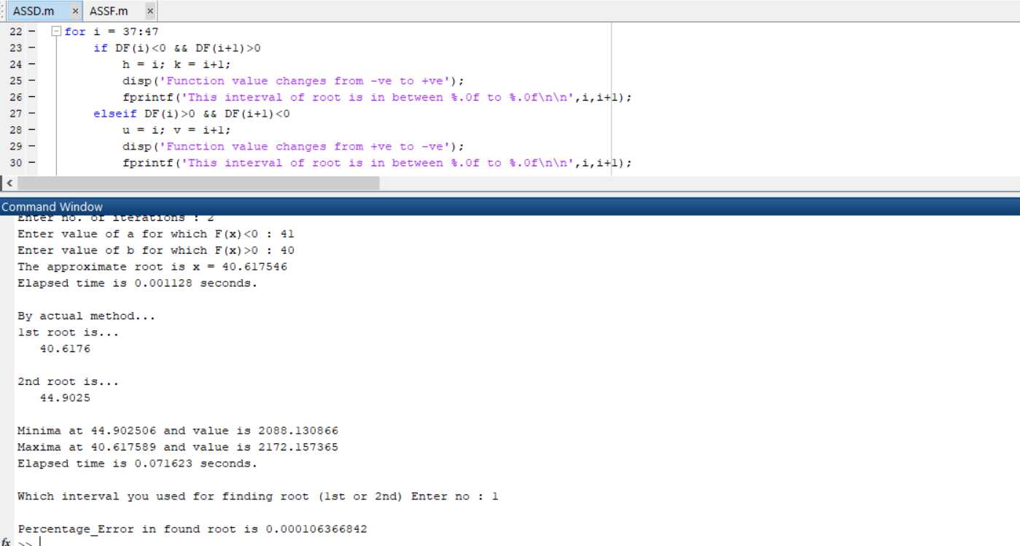

Slide 20
Finding Maxima & Minima by derivative of function only
Euler's Method
Euler's Modified Method
Runge Kutta 2nd order Method
Runge Kutta 4th order Method
Using these we can directly find Maximum & Minimum Values.

Slide 21
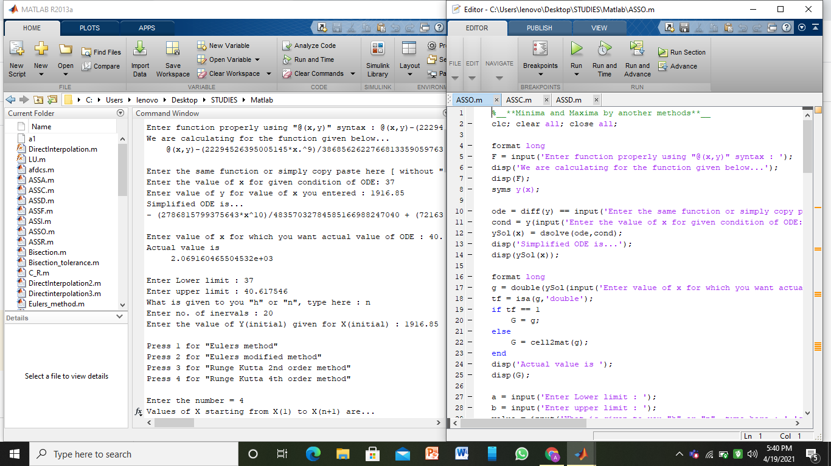

Slide 22


Comparison with other similar data sets
India's largest retailer
USA’s largest retailer

Slide 23
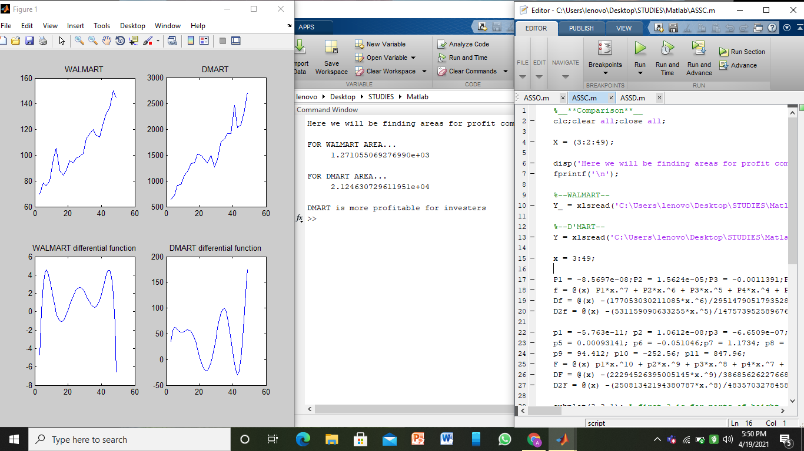

Slide 24
These models are very basic of Machine Learning Models and Data Science Engineering , All these models are used in this engineering fields in real Corporate life for real life problems.

Slide 25
PROJECT TIMELINE
Week 1 (13/03 - 20/03) -- 3 Hrs | Exploring topics & Selecting problems
Week 2 (21/03 - 27/03) -- 4 Hrs | Interpolation methods + Codes
Week 3 (28/03 - 03/04) -- 6 Hrs | Regression methods + Codes
Week 4 (04/04 - 10/04) -- 5 Hrs | Integration methods + Codes
Week 5 (11/04 - 17/04) -- 5 Hrs | Transcendental Equation
Week 6 (18/04 - 22/04) -- 8 Hrs | O.D.Eq + Comparison + Recording video

Slide 26
So , We conclude the presentation here...

Slide 27


